Slide 1
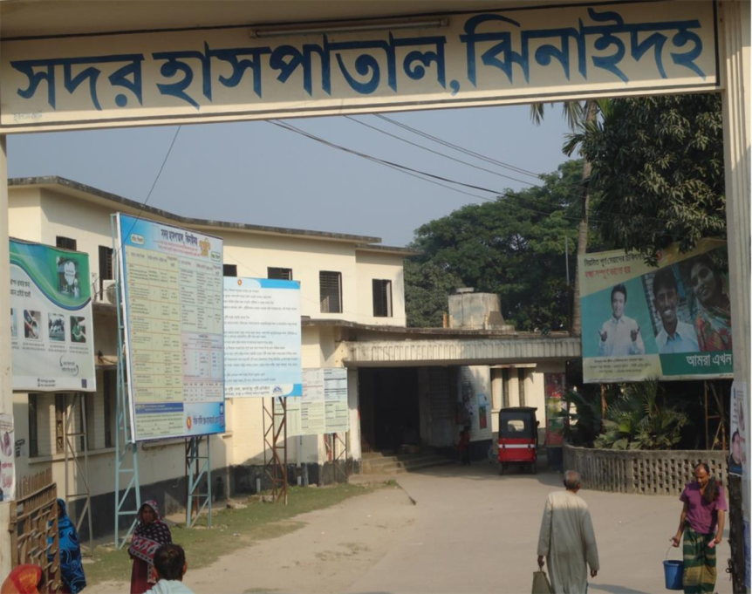
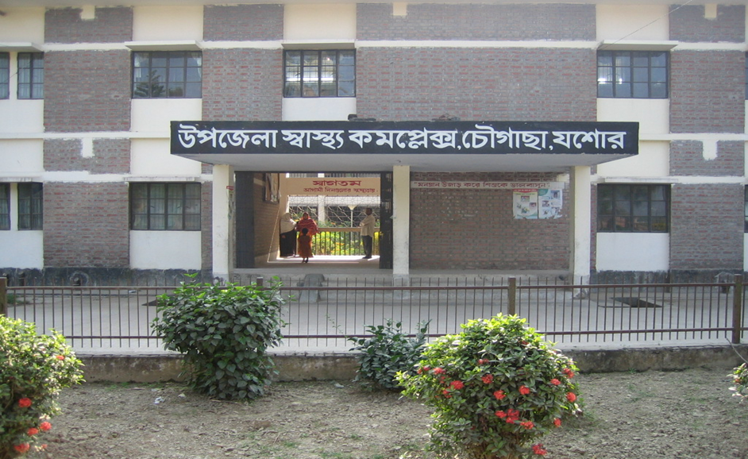
Community Support System in Chowgacha UHC & Jhenaidah Sadar Hospital
Dr. Md.Emdadul Haque
Senior Consultant (Obst & Gynae)
Sadar Hospital Jhenaidah

Slide 2

50 BEDED UPAZILA HEALTH COMPLEX
Chowgacha, Jessore.

Slide 3
A Sub-district level Women-Friendly Hospital with a Vision …
Maximum utilization of Govt.
resources with
honesty and sincerity
Integrated approach of
Administration, Community
Leaders & Health
Management
Providing Effective and
prompt services
through improved
management system

Slide 4
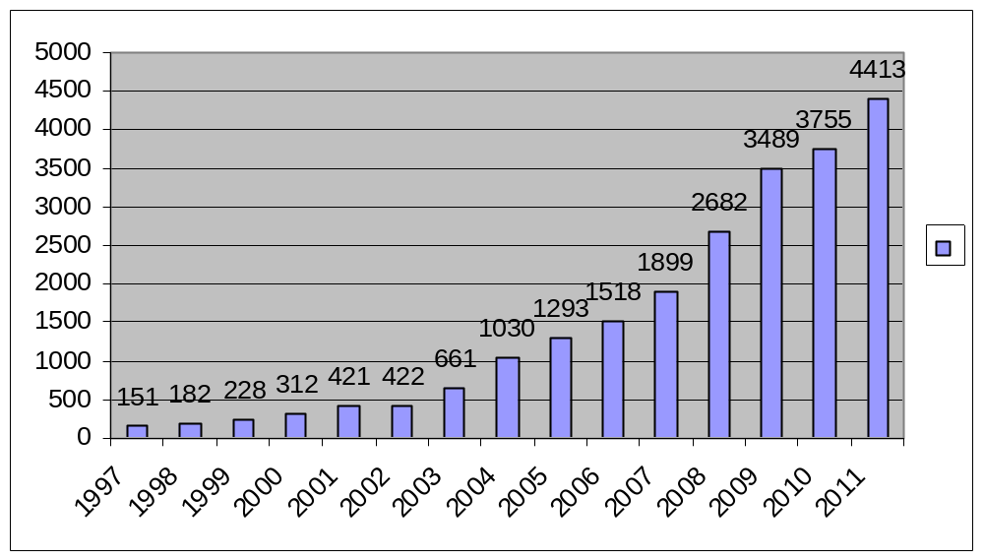
Upazila Health Complex
CHOWGACHA , JESSORE.
EOC Activities : 1997- 2011 (Hospital Delivery )

Slide 5
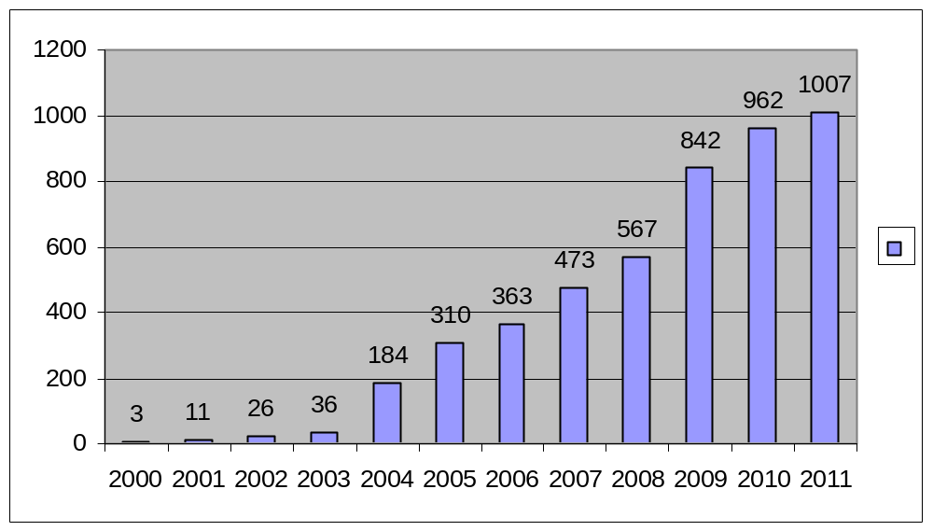
Upazila Health Complex
CHOWGACHA , JESSORE.
EOC Activities : 2000 - 2011 (Caesarian Section)

Slide 6
Upazila Health Complex
CHOWGACHA , JESSORE.
Comparative Data of Delivery of best performing EOC center of Khulna Division in 2011
SL No | Name of institute | NVD | Vacuum Del. | V. Breech | C. Section | Total
01. | Chowgacha UHC | 3346 | 34 | 26 | 1007 | 4413
02. | Ad-din Hospital Jessore. | 1124 | 0 | 0 | 1864 | 3492
03. | Khulna Medical College Hospital | 1581 | 58 | 18 | 1356 | 3013
04. | 250 bed Hospital, Jessore | 1327 | 2 | 25 | 1498 | 2852
05. | 250 bed Hospital, Kustia | 1728 | 0 | 34 | 915 | 2677

Slide 7
Upazilla Health Complex
CHOWGACHA , JESSORE.
COMMUNITY SUPPORTED MANPOWER
TOTAL :46
  Volunteers :26
  Cleaners & guards :16
  Others :04
  The remunerations come from
  Outsourcing :25
  Service provider :21
  The amount of remuneration ranging from 200/= To 8000/=tk. Per month depending upon the style of work, which costs a total of nearly 90,ooo/=Tk per month.

Slide 8
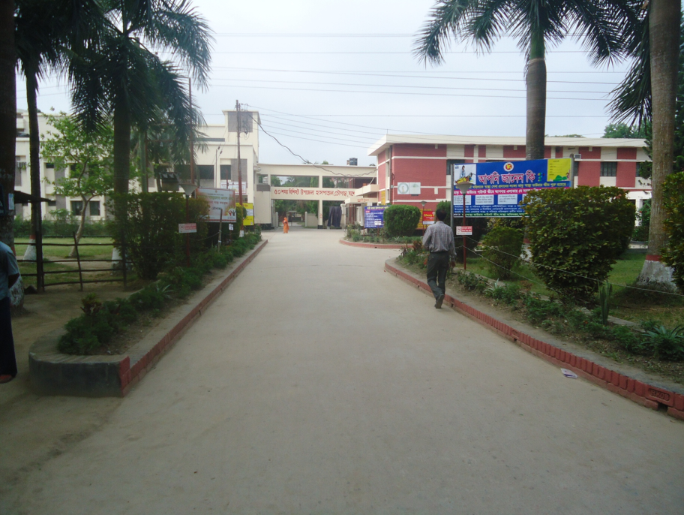
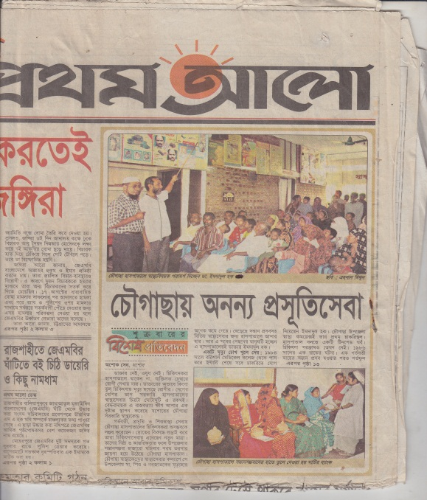
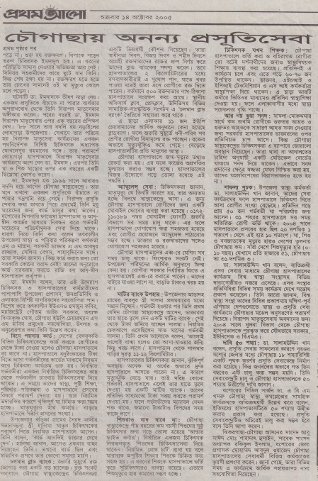
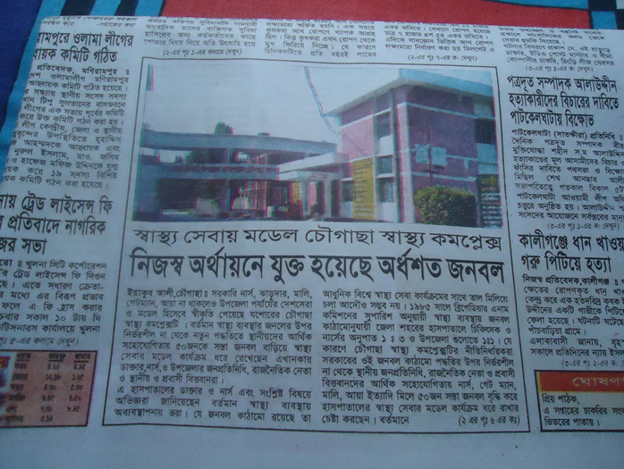
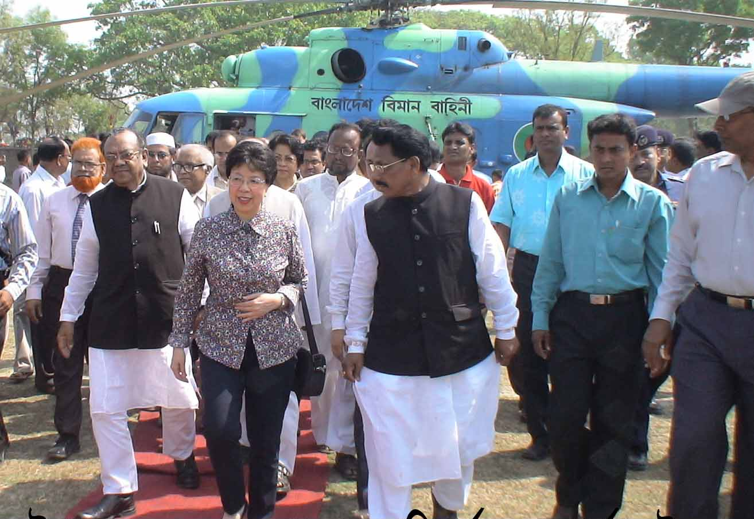

Slide 9

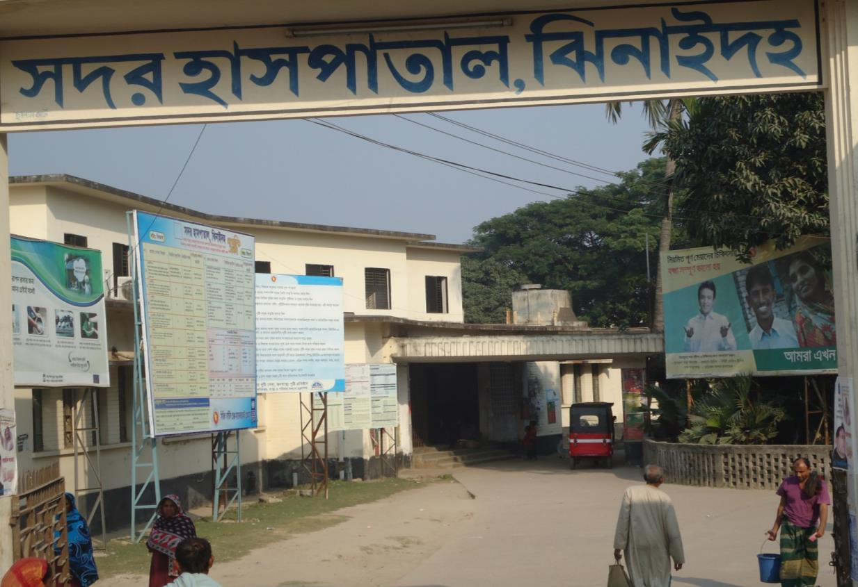
Community Participation in
SADAR HOSPITAL, JHENAIDAH

Slide 10
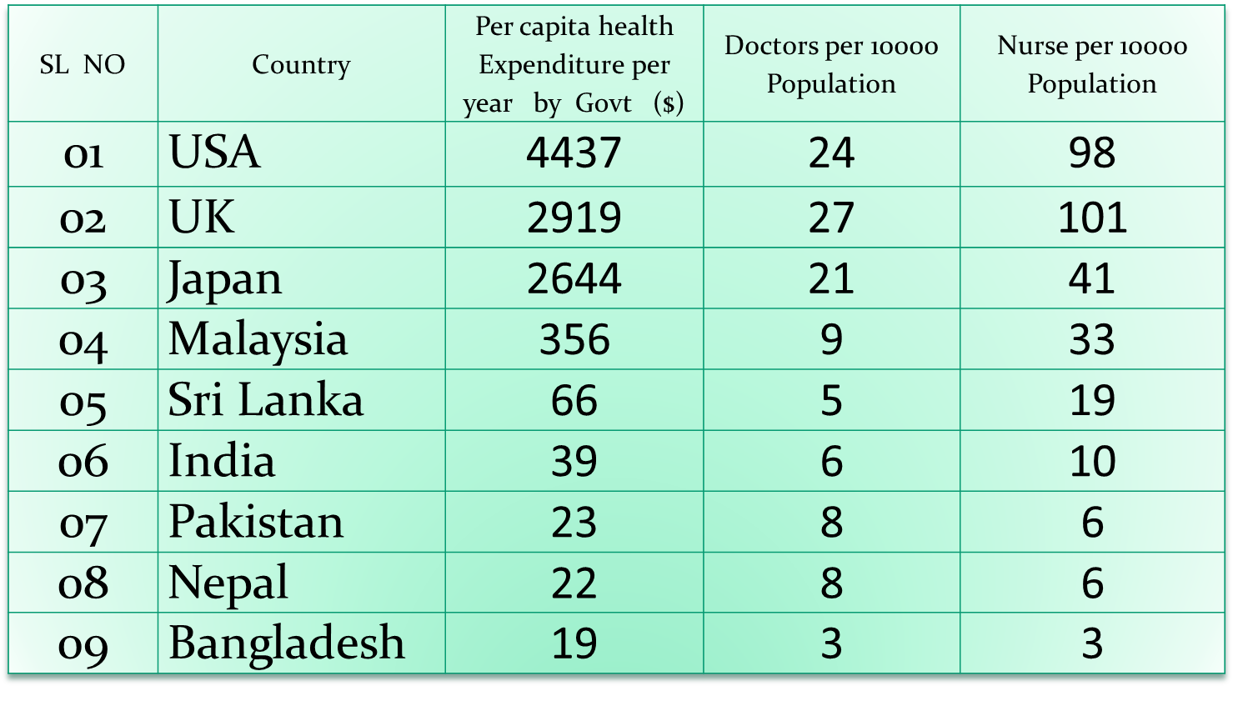
Comparative data of health facilities of different country of the world
From internet 2014

Slide 11
Comparative Data of 3 best performing maternity hospitals in Srilanka, Tanzania and Bangladesh
Serial No | Castle Street Maternity Hospital, Srilanka | Mbeya Maternity Hospita, Tanzania | Sadar Hospital, Jhenaidah, Bangladesh
Bed (Govt.) | 417 | 110 | 5 (Ext. 16)
Nurse | 325 | 45 | 6
Total Delivery | 16,399 (2010) | 6,000 (2014) | 3,034 (2015)
C-Section | 30% (4,920) | 33% (2,000) | 36% (1,090)

Slide 12

Sadar Hospital, Jhenaidah
Important post of Human Resources
Serial No. | Person | Post | Vacant
01 | Doctor | 40 | 21
02 | Nurse | 48 | 02
03 | MLSS | 10 | 0
04 | Ward boy | 03 | 03
05 | Ayah | 03 | 03
06 | Cleaner | 07 | 00
07 | Guard | 03 | 00
08 | Gardener | 01 | 00
09 | Electrician | 01 | 00
10 | Trolley man | 00 | 00
11 | Others | --- | ---
 | Total | 150 | 29

Slide 13
Jhenaidah Sadar Hospital, Jhenaidah
Achievement of the Hospital
Active Community Participation
2. Improve Performance of Obstetric Program
3. Improved Cleanliness and Beautification of Campus.
4. Improved Pediatric Service.
5.Created a blood donor organization (Manabota) for Thalassemia patients.
6. Improved Security.
7. Improved Financial Management
8.The Hospital is awarded as one of the 5 best hospitals of the country and also awarded for 5’s KIZEN.
9. Improved emergency department service.
10. Involvement of national and international agencies like BPATC, JICA, ICDDRB, UNICEF, Save The Children.
11. Ministery of health take initiative of piloting among the district hospitals of Bangladesh.

Slide 14
Community Support System in Sadar Hospital
51 manpower (Cleaner 19, Ayah & ward boy 19, Guard 1, Gateman 3, Volunteer 6, Trolley man 3 ) get TK. 2000 to TK. 3000 per month per person supported by the community.
MP of Jhenaidah-2 donated 14 manpower support.
Doctors of the hospital and Jhenaidah town supports 15 man power.
Mayor of Jhenaidah Paurasava plays an important role in security, cleanliness, repaired the boundary wall, rearrangement of pediatric ward, supply of celing fans, made 4 dustbins and supports 3 man power.
Retired secretary donated a generator for 24 hours OT service with a cost of nearly 33 thousand taka.
Chairman of Zahedee foundation supports 10 manpower and an intercom with a cost of nearly two lac taka.

Slide 15

Sadar Hospital, Jhenaidah
Bed Occupancy Rate from 1998 to 2015
Sl. No | Year | Bed Occupancy Rate
01 | 1998 | 126%
02 | 2011 | 146%
03 | 2013 | 165%
04 | 2014 | 180%
05 | 2015 | 193%

Slide 16

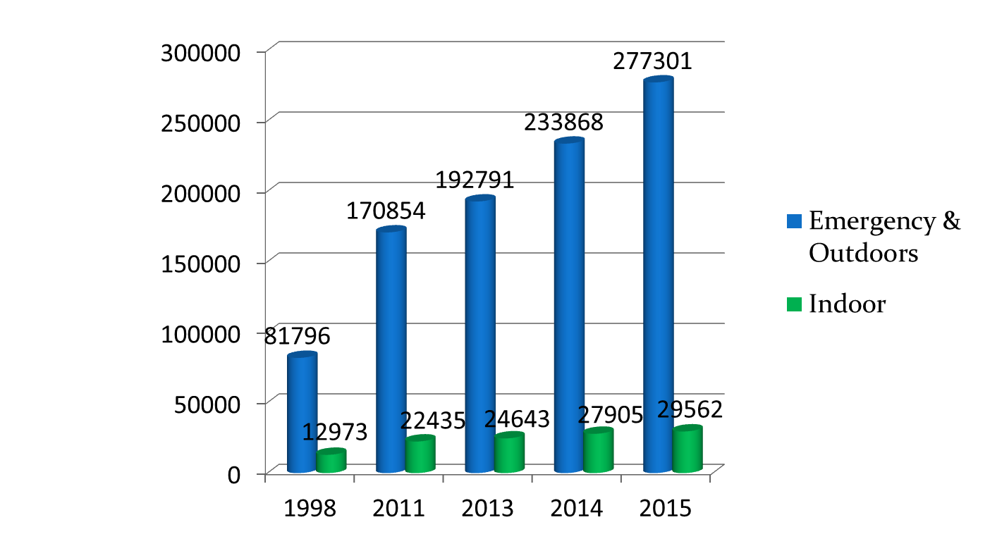
Sadar Hospital, Jhenaidah
Emergency & Out Door, Indoor Service 1998 to 2015

Slide 17

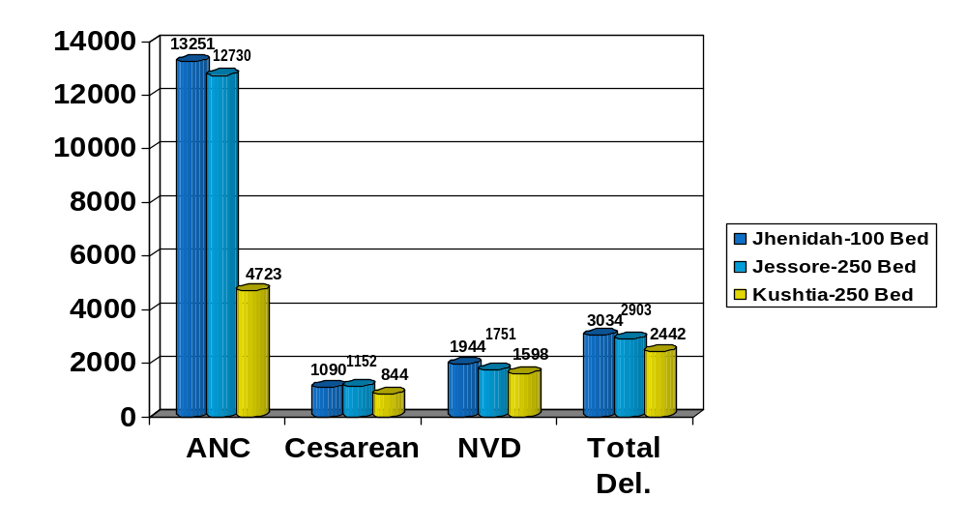
Comparative Data of EOC Service of 3 Best Performing District Hospital of Khulna Division in 2015

Slide 18

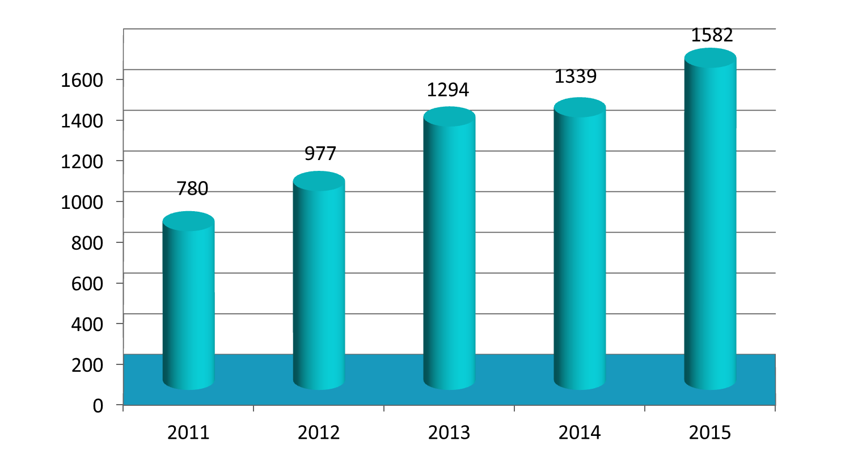
Operation Service (Major) 2011 to 2015
Sadar Hospital, Jhenaidah

Slide 19
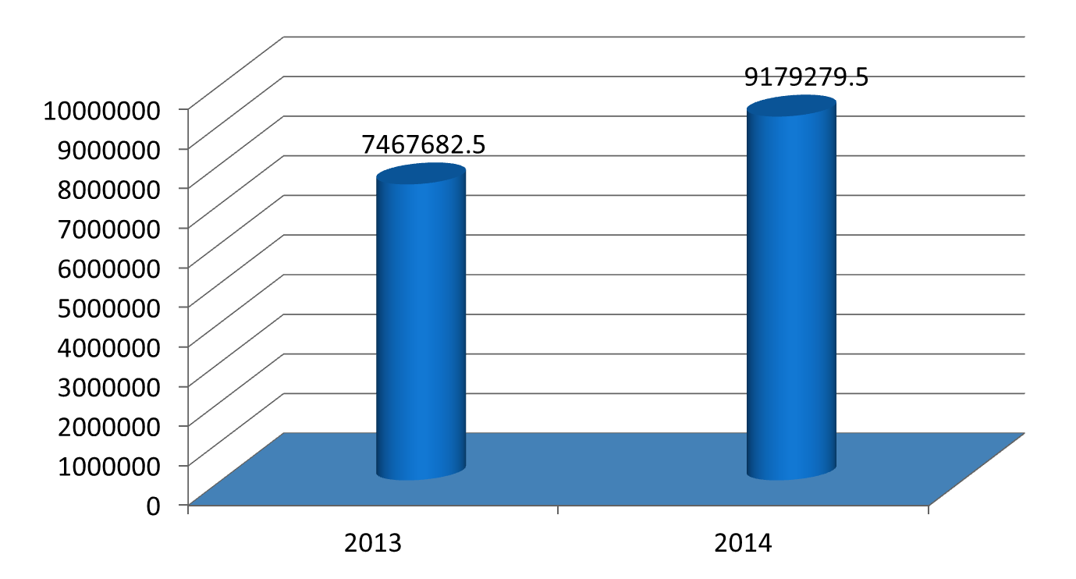
Comparative data of revenue income in Jhenaidah district in 2013 & 2014
Sadar Hospital, Jhenaidah

Slide 20
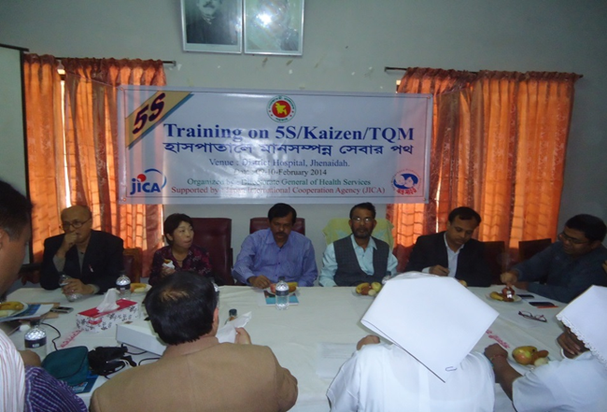
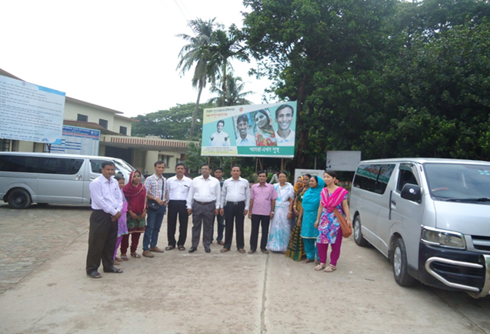
Introduction of TQM activities and Visit to Shatkhira District Hospital
  In 9 February, 2014, 5S-CQI -TQM program started by DGHS & SMPP JICA. Staff orientation on 5S-CQI-TQM process.
  5th August, 2014 an Idea sharing visit of 15 team members headed by civil surgeon at Shatkhira District Hospital with the help of JICA.

Slide 21
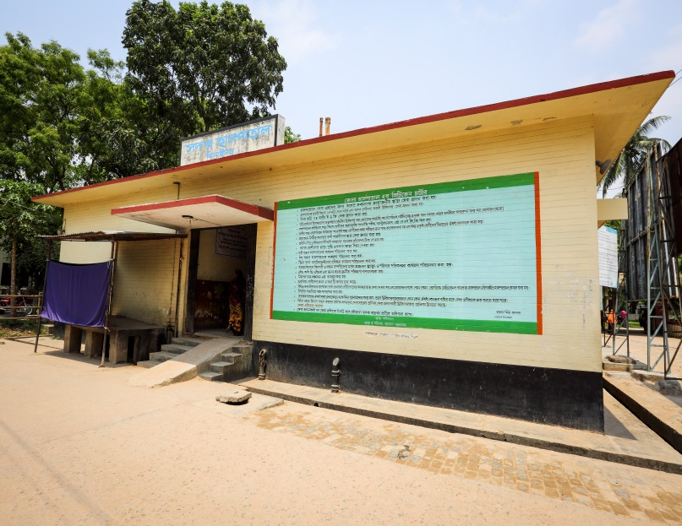
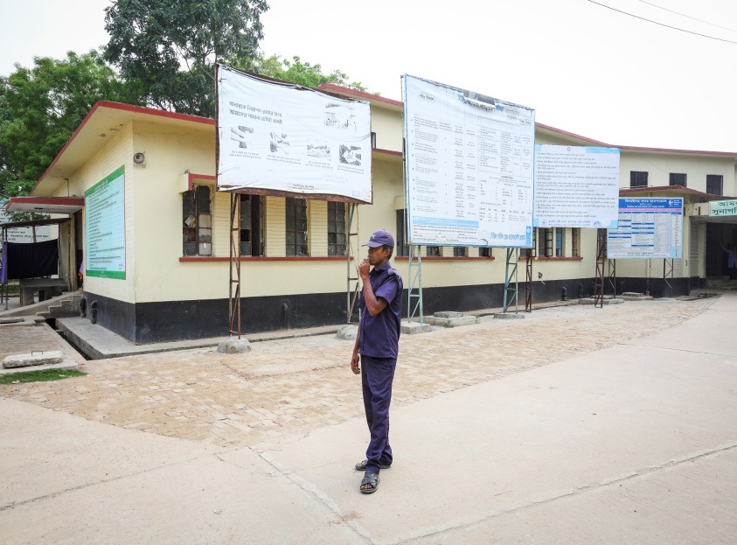
Display of citizens’ charter of Sadar Hospital.
Community supported guard is removing cycle, van and easy bike from the campus.

Slide 22
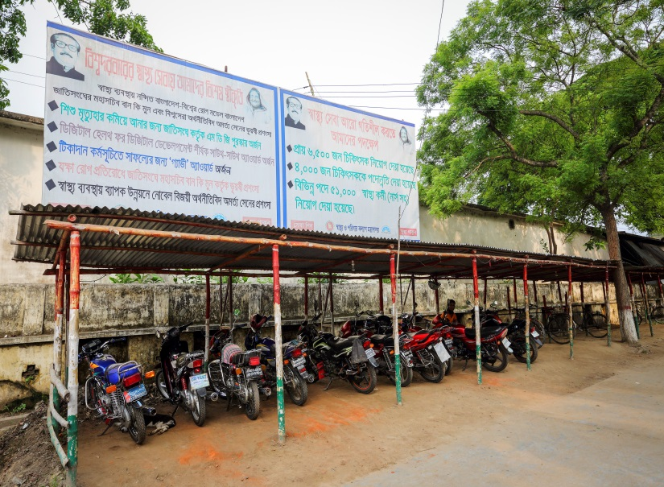
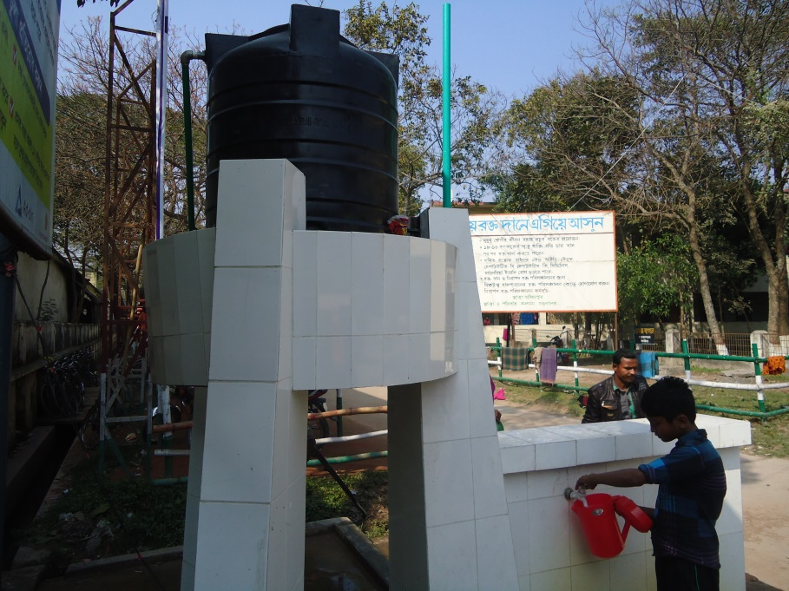
Cycle Stand
To secure the cycle and motor cycle of the patients and their attendants.
Safe drinking water supply for the patients and their attendants.

Slide 23
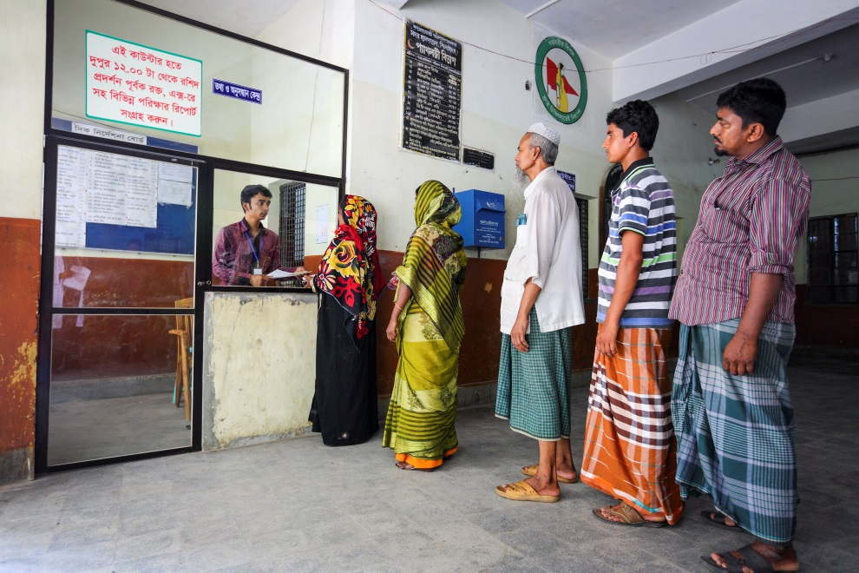
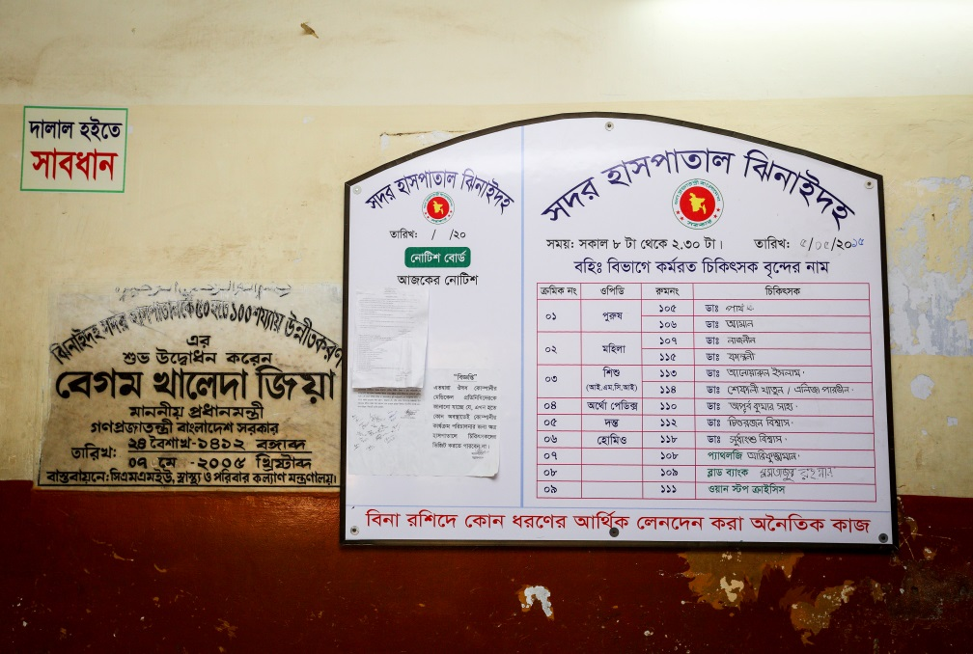
Hospital reception and information center for the patient and their attendance are developed by the community support system.
Display of the duty roaster of outdoor doctors.

Slide 24
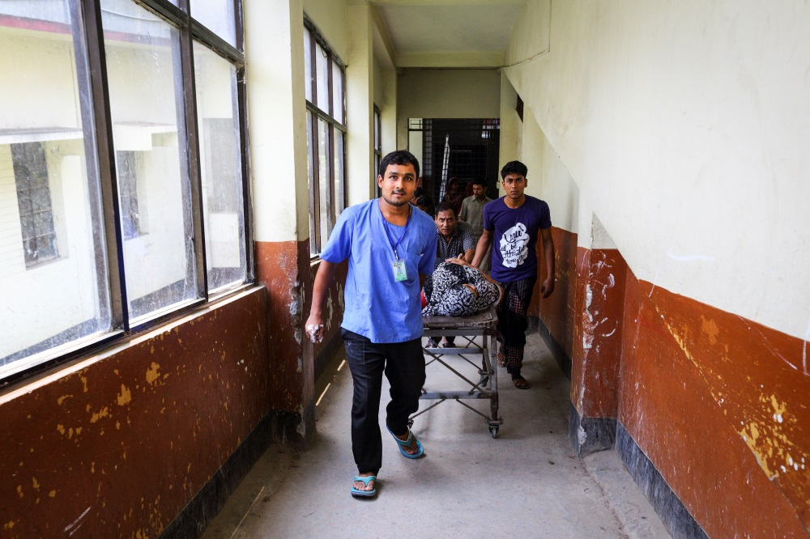
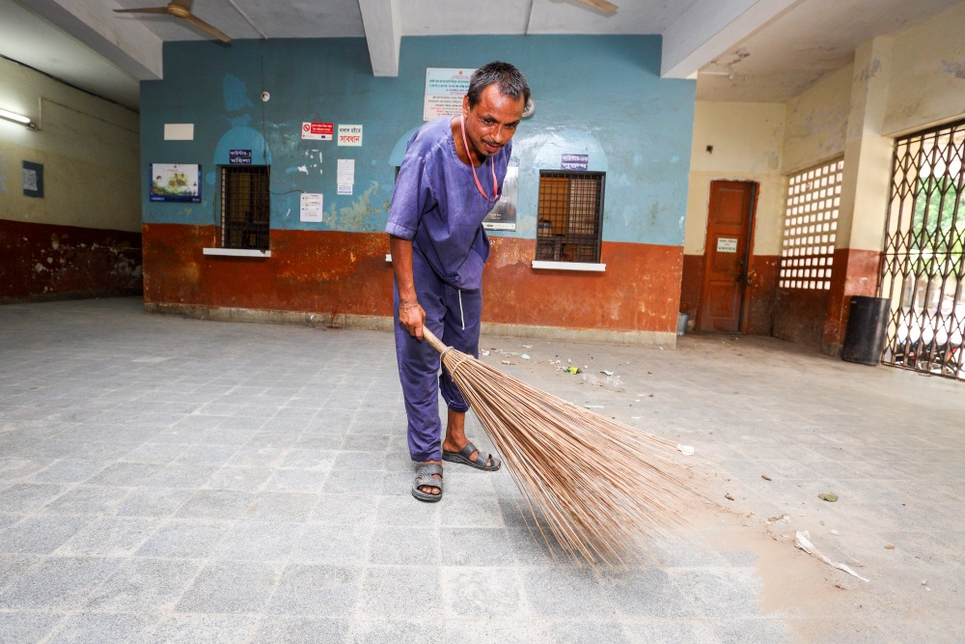
Community supported trolley man is carrying a patient.
Community supported cleaner is cleaning the hospital.

Slide 25
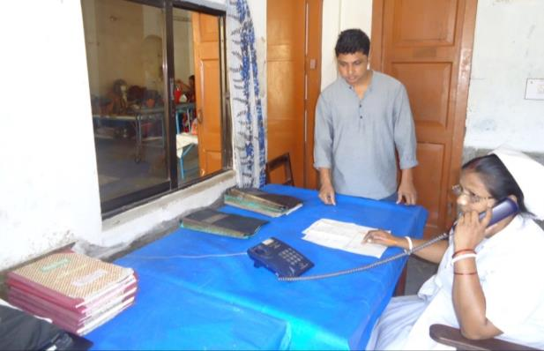
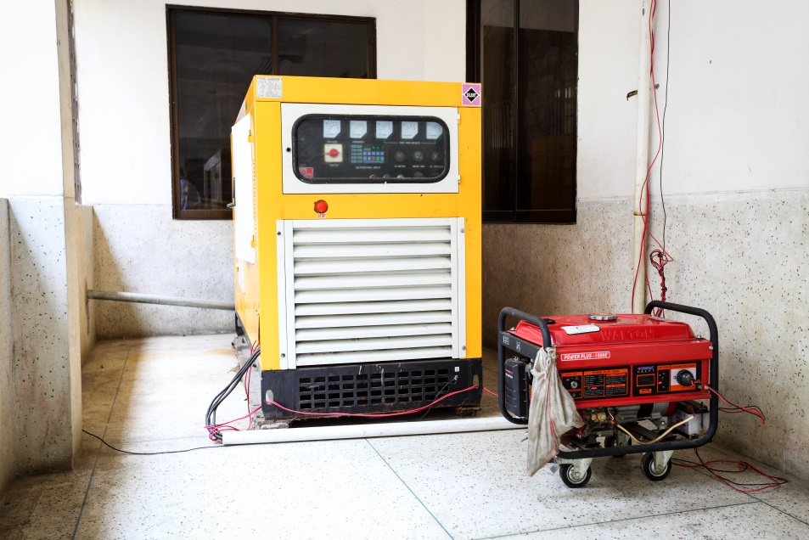
To facilitate easier communication among the hospital staff an intercom is donated by an honorable local industrialist and thus the efficiency of the service has been improved
A non-operating government generator is activated and a new generator is supplied by the community to ensure electric facility.

Slide 26
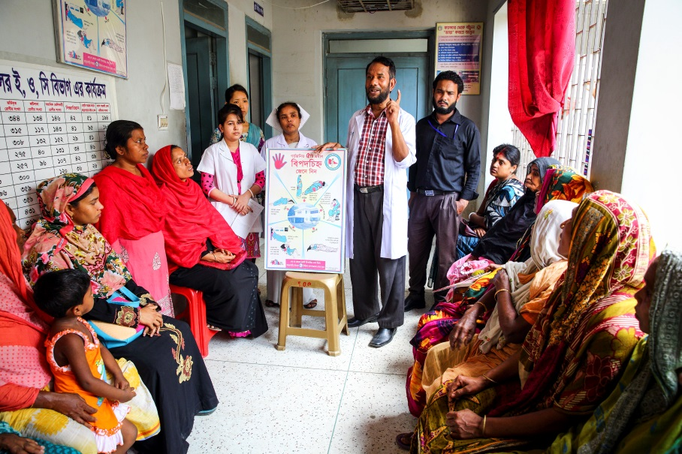
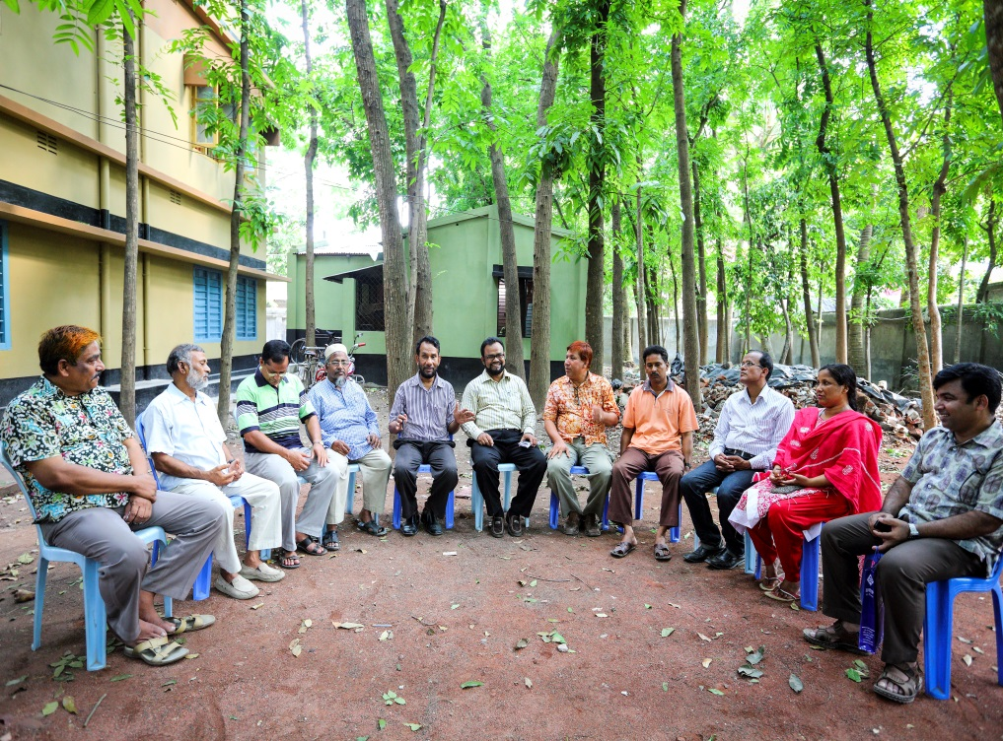
Creation of awareness by Health Education for the patients and their attendances.
Motivation of the community, the teachers, reporters, social workers, cultural activists and donors of the hospital .

Slide 27
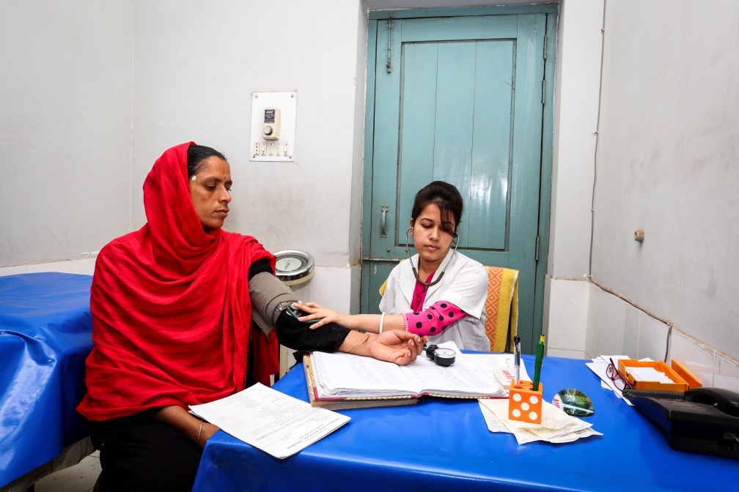
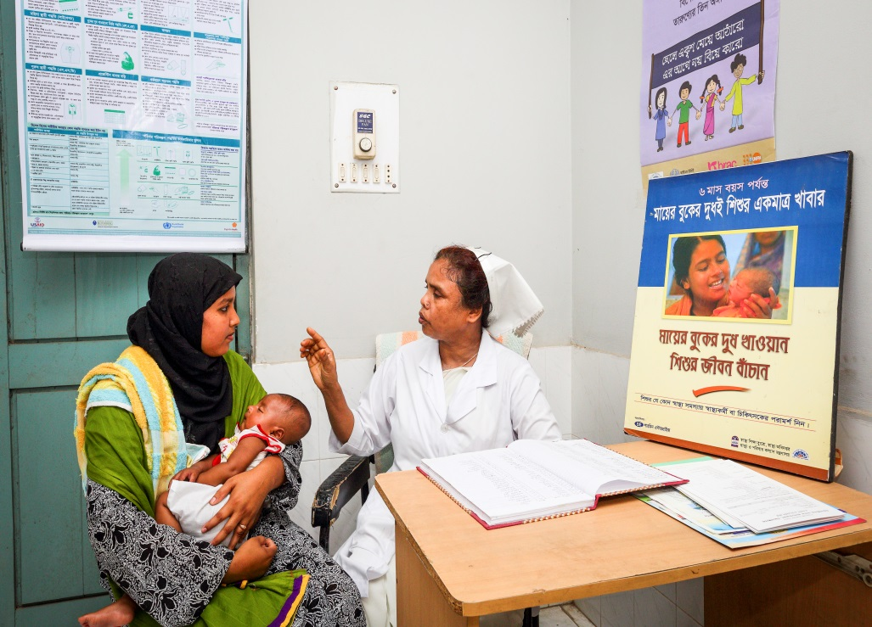
Antenatal and postnatal care of pregnant mother in antenatal corner of EOC word.
Breast feeding and family planning corner of EOC word.

Slide 28
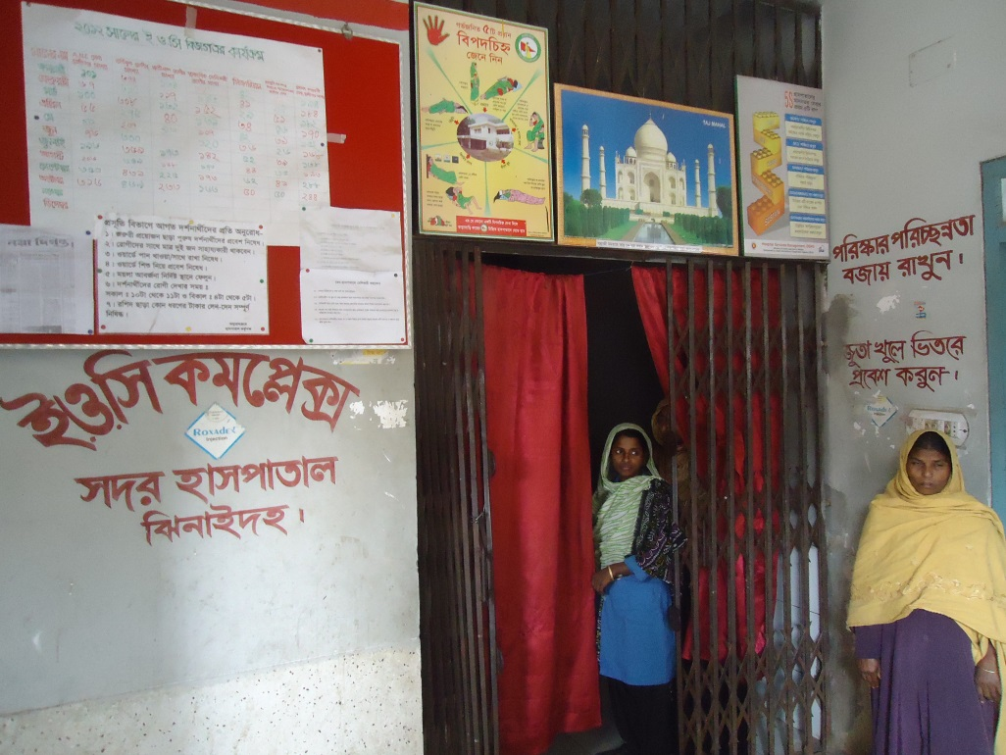
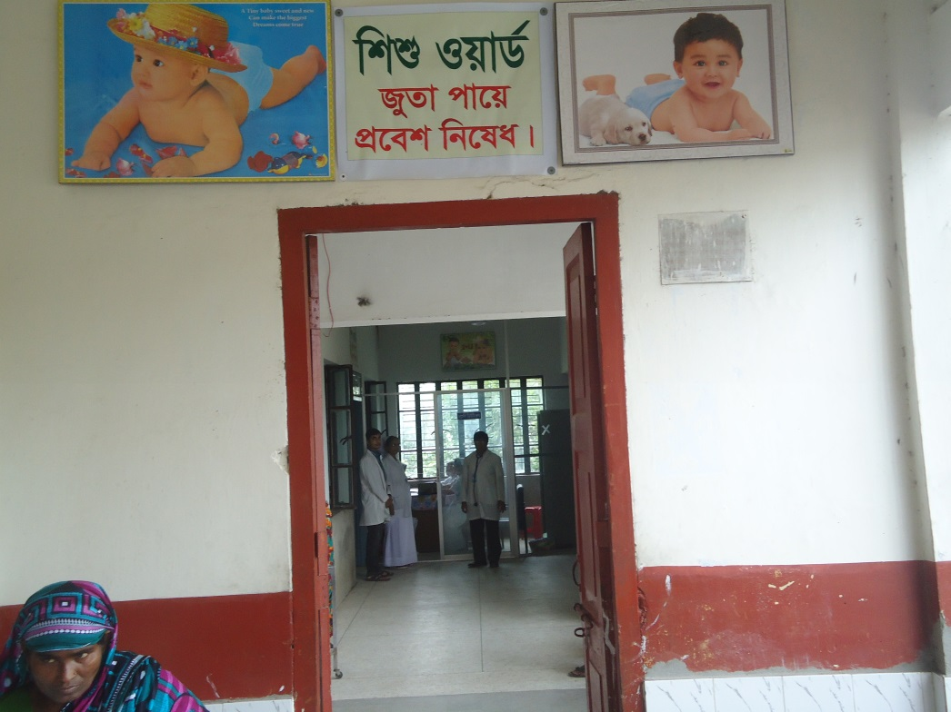
Improved EOC (Emergency Obstetric Care) word service.
Improved pediatric word.

Slide 29
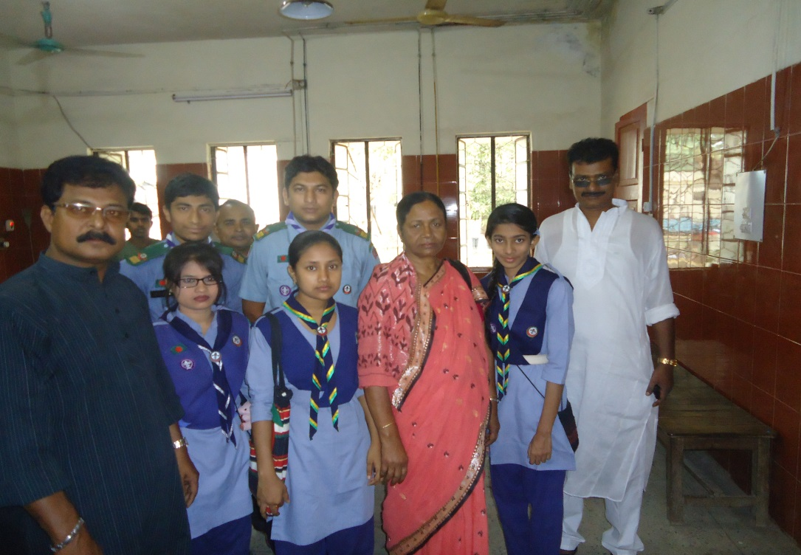
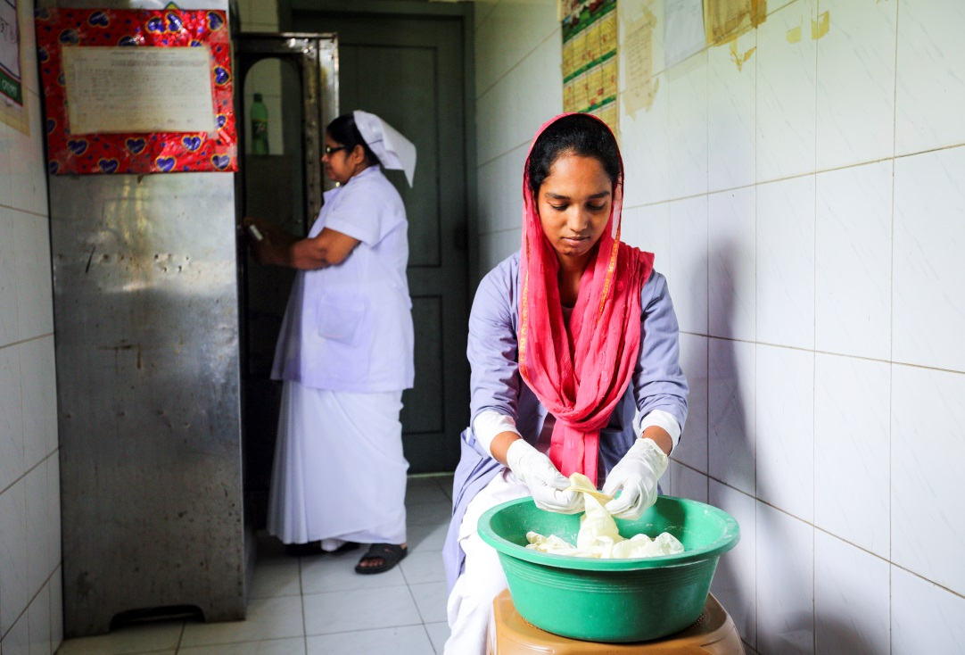
Girls’ Guide are working in the outdoor for lining of the patients to take proper service.
College going poor students are working in the hospital as nursing assistant (Volunteer).

Slide 30
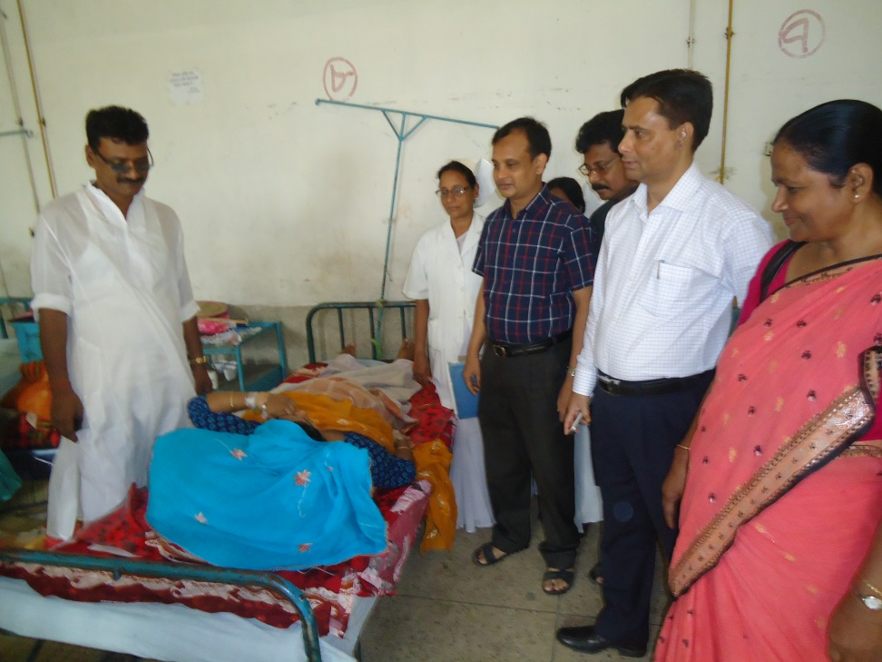
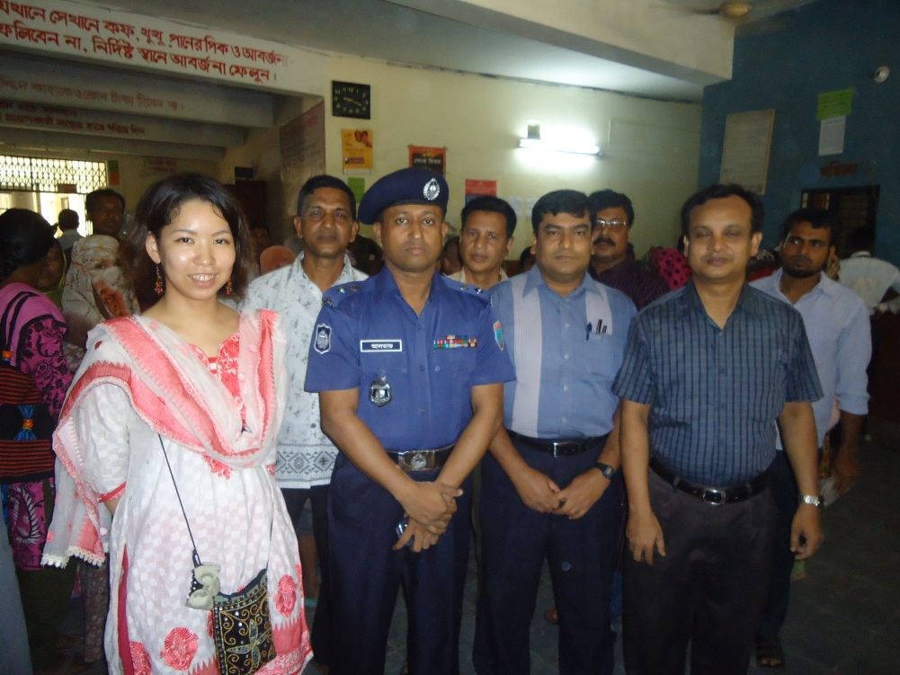
Deputy Commissioner (DC), Jhenaidah visited the Sadar Hospital to observe the Hospital activities.
Superintendent of Police (SP), Jhenaidah visited the Sadar Hospital to observe the Hospital activities and to ensure security of the hospital.

Slide 31
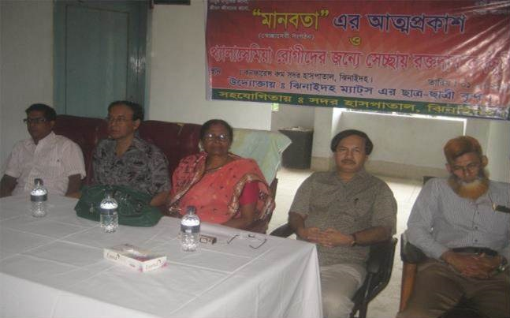
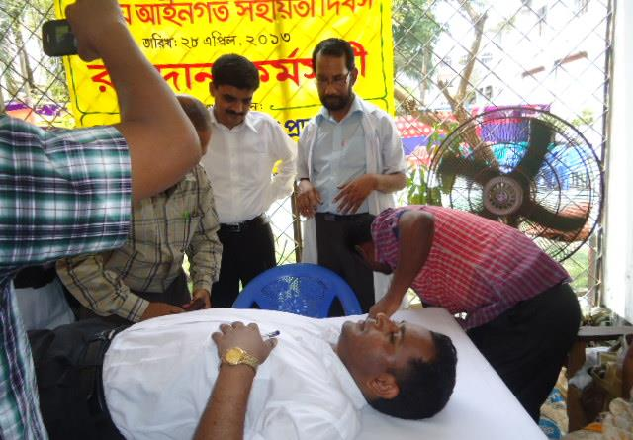
MANOBOTA- a volunteer blood donor organization has formed by the doctors and SACMOs to donate blood for the thalasemic and other patient of the hospital.
A blood donation camp arranged by District Judge of Jhenaidah with the help of MANOBOTA.

Slide 32
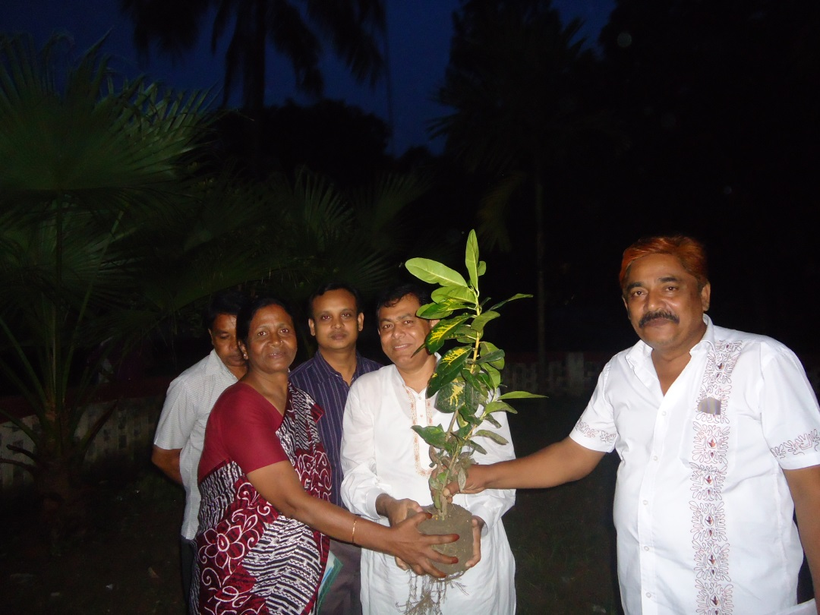
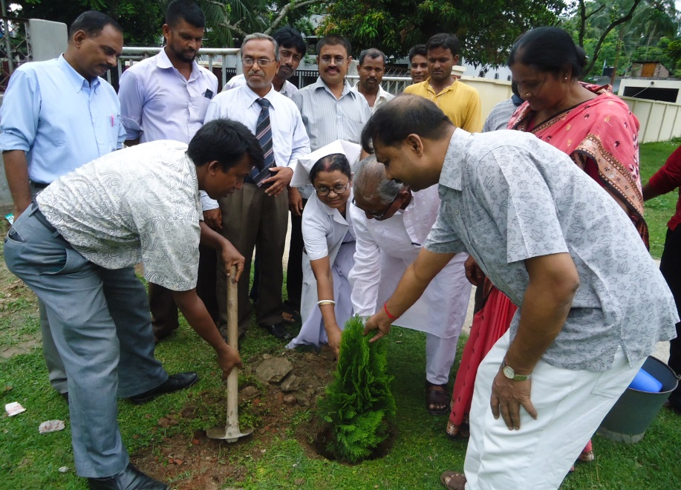
Hospital campus beautification started by previous MP of Jhenaidah-2.
Beautification plant is planted by Zilla Praised Administrator and Upazilla Praised Chairman.

Slide 33
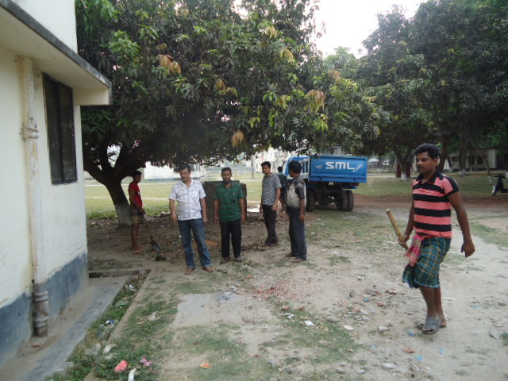
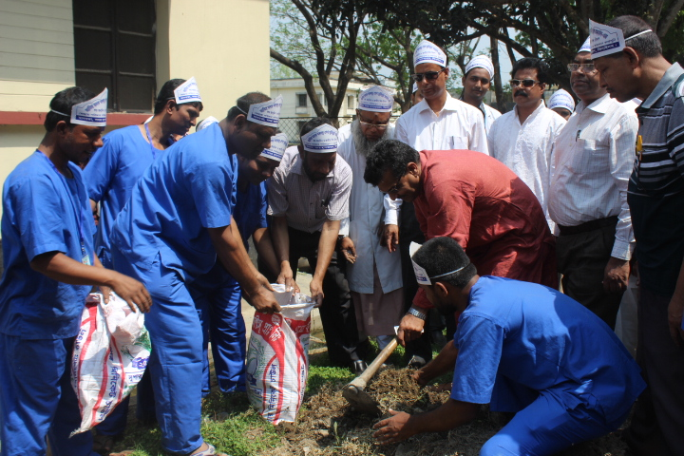
Hospital garbage is removed regularly by the Paurasava.
17th,March “a big cleaning day” is being celebrated to clean the hospital by DC, Mayor, Civil Surgeon & staffs of the hospital , under the leadership of Superintendent.

Slide 34
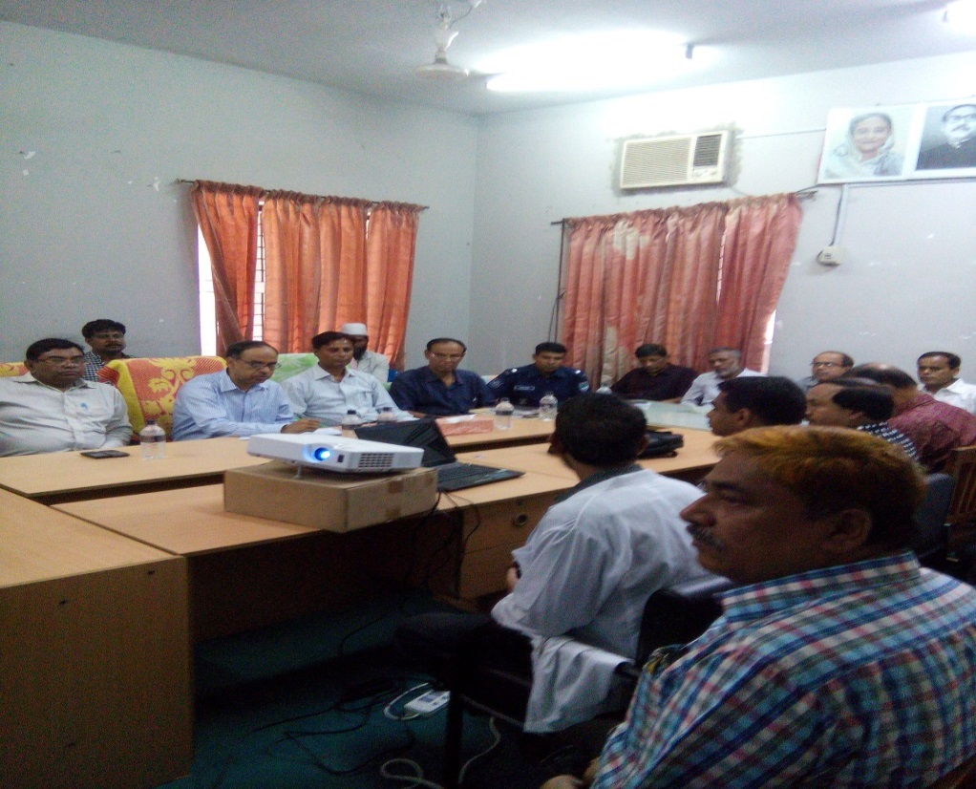
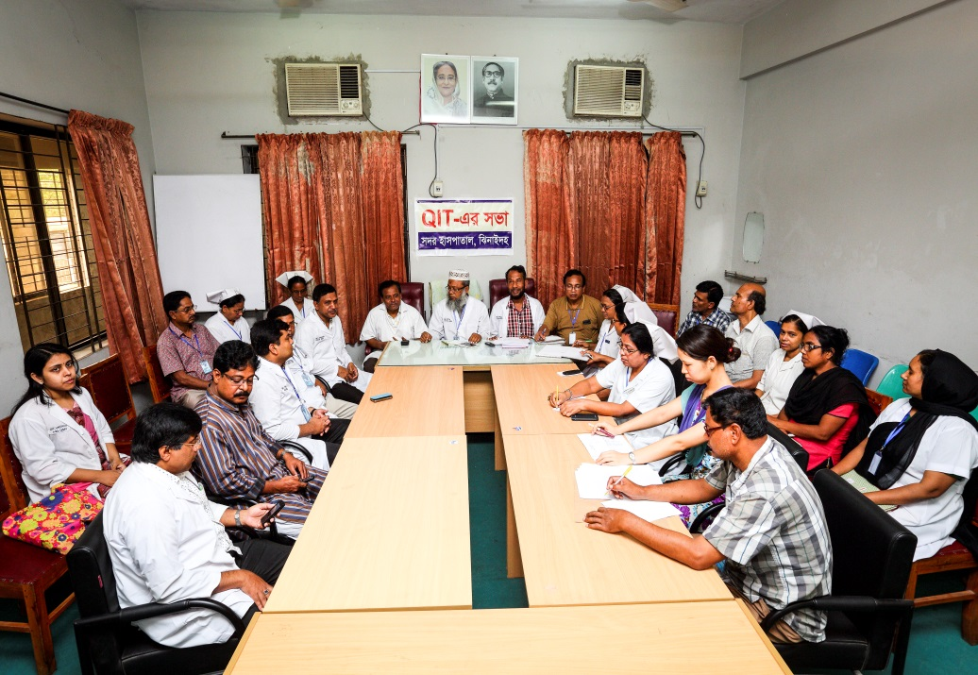
Meeting of the stakeholders with the stakeholders and donors of Jhenaidah Sadar Hospital with additional secretary (health) Md. Asadul Islam.
Meeting of QIT (Quality Improvement Team) is held in the conference of Jhenaidah Sadar Hospital.

Slide 35
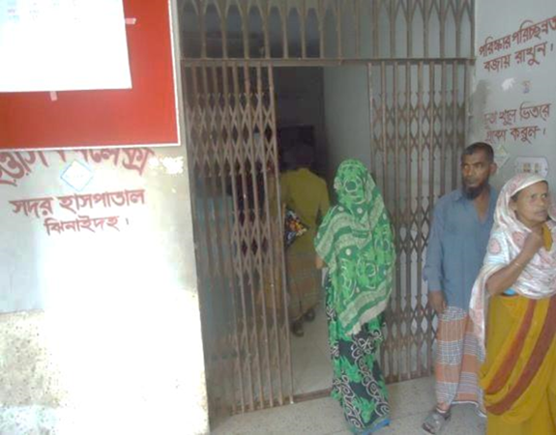
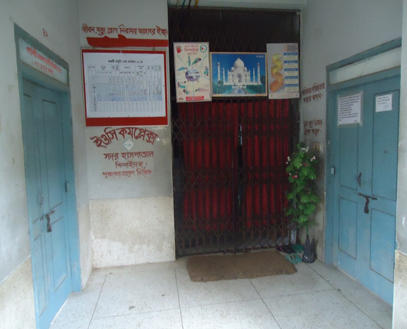
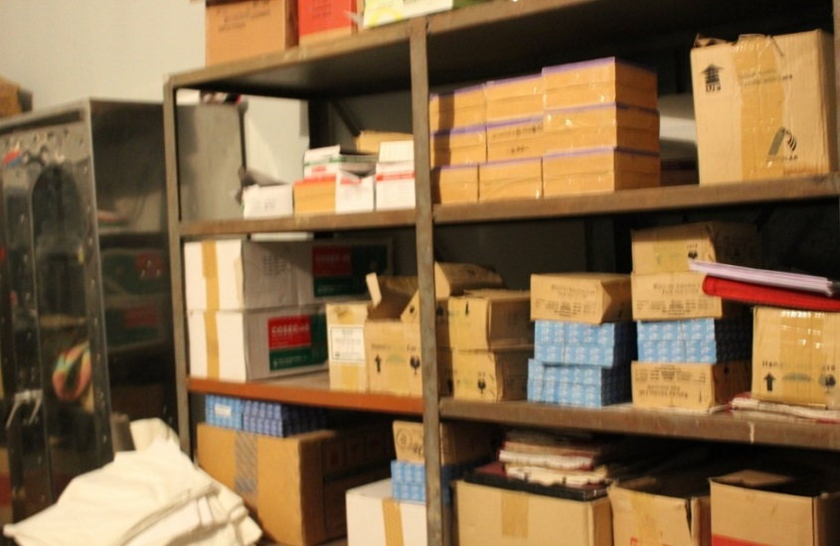
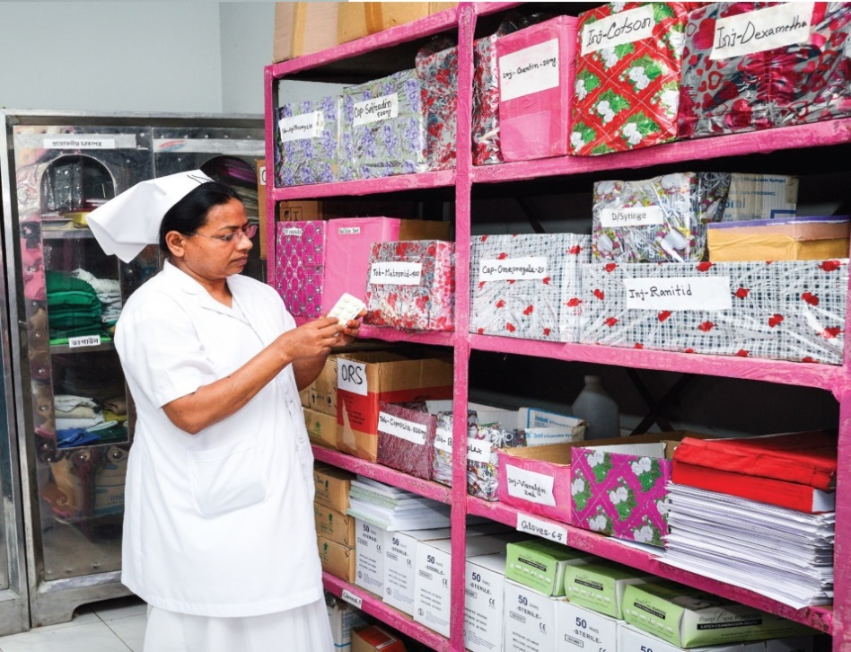
Changes in EOC Ward
Before
After
Before
After
Before

Slide 36


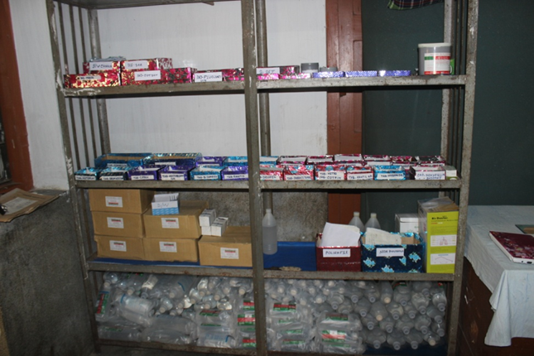





Changes in Surgery Ward

Slide 37




Changes in Office & Medicine Ward
Before
After
Before
After

Slide 38




Changes in Gardens of The Hospital
Before
After
Before
After

Slide 39




West Management & Campus Protection
Before
After
Before
After

Slide 40






Slide 41


Slide 42

CASTLE STREET MATERNITY HOSPITAL, Srilanka
(Est. 1950)
Bed – 492
  Obs. & Gynae units – 5 (417 Beds)
  Neonatal ward – 75 beds
Nurses – 325
Midwifes – 66
Bed occupancy rate – 92%
Total delivery – 16399 (2010)
  C Section – 30% (4920)

Slide 43

Mbeya Maternity Hospital,Tanzania
Bed: 150 (Maternity: 110; Neonatal: 40)
Doctor: 10 (5 Specialists, 5 MOs)
Nurse: 60
ANC coverage: 90% (1st)
Total Deliveries: 6000 (2014)
C-section rate: 35-40% (2000)
Anesthesia is given by Nurses trained for 2 years
Delivery room: 7 (very clean with maintaining privacy)
Maternal and neonatal ICU is there for critical patients
Reflection of 5S-Kaizen is visible everywhere

Slide 44
Jhenaidah Sadar Hospital, Jhenaidah
Bed : 13 (EOC : 5; Pediatric : 8)
Doctor : 4 (Specialist :3 ; MO :1 )
Nurse : 10
Total Delivery : 3034 (2015)
C-Section : 33% (1007)
ANC Coverage: 6028

